Slide 1
InfoTrack
Instruction selenium framework and execute the tests
Created by: Quy Bui
Date: April, 2024

Slide 2




1. Installation
Using Java as programming language (JDK 18)
Maven
TestNG
Eclipse IDE
Notes:
Testing Approach
The primary objective of a test plan is to communicate the testing approach/methods to the reader. This section must list the types and number of rounds of testing, the defect tracking process and list of tools to be used for the project.

Slide 3
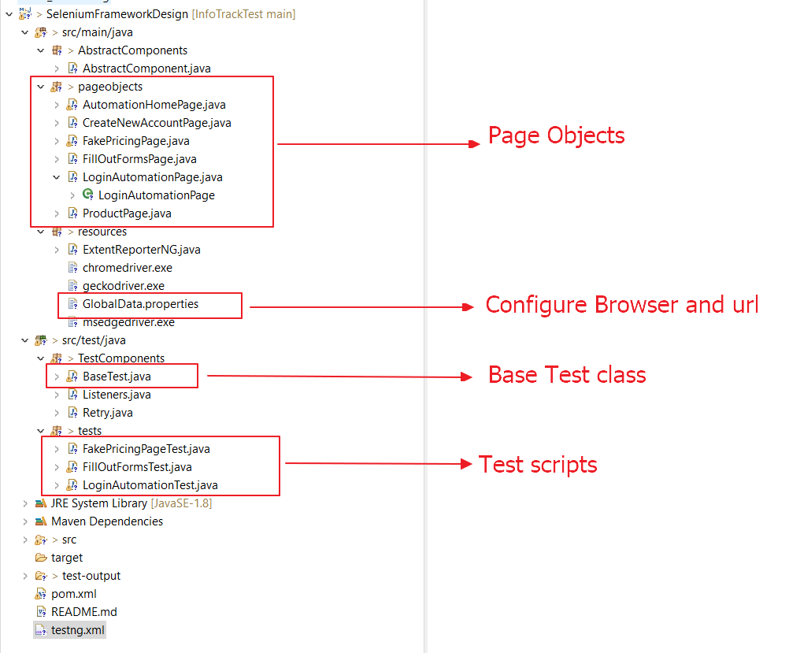
2. Simple Framework Structure
Black-box Test Techniques

Slide 4
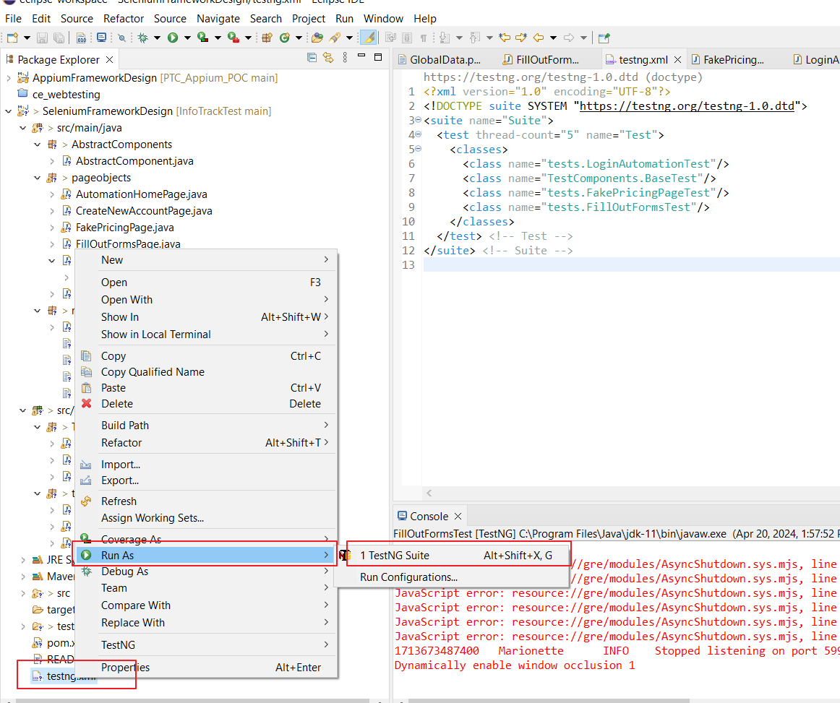
3. Run Tests
Run all test scripts: R-click on testing.xml from the bottom, and select Run as > TestNG Suite

Slide 5
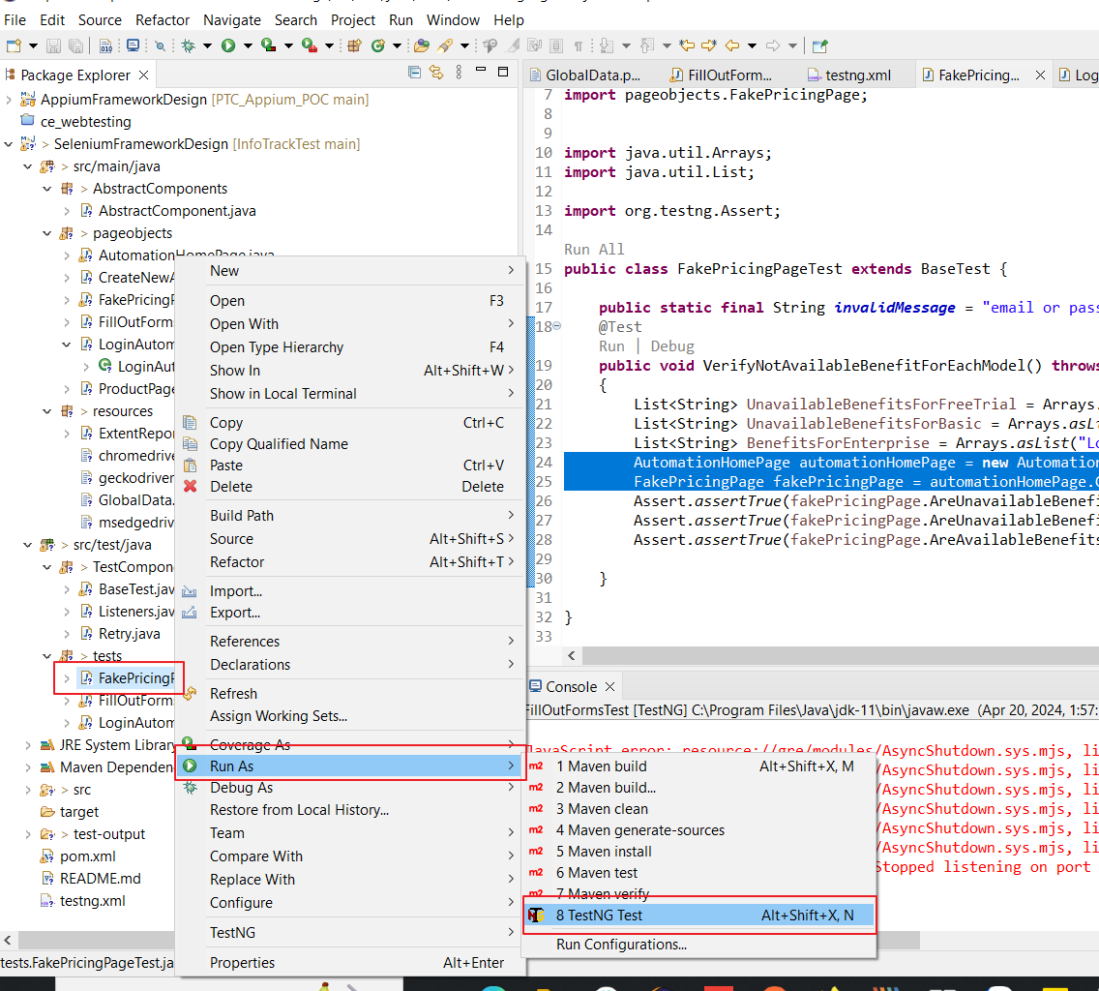
3. Run Tests
Run Single test: R-click on test script, and Run As > TestNG Test

Slide 6
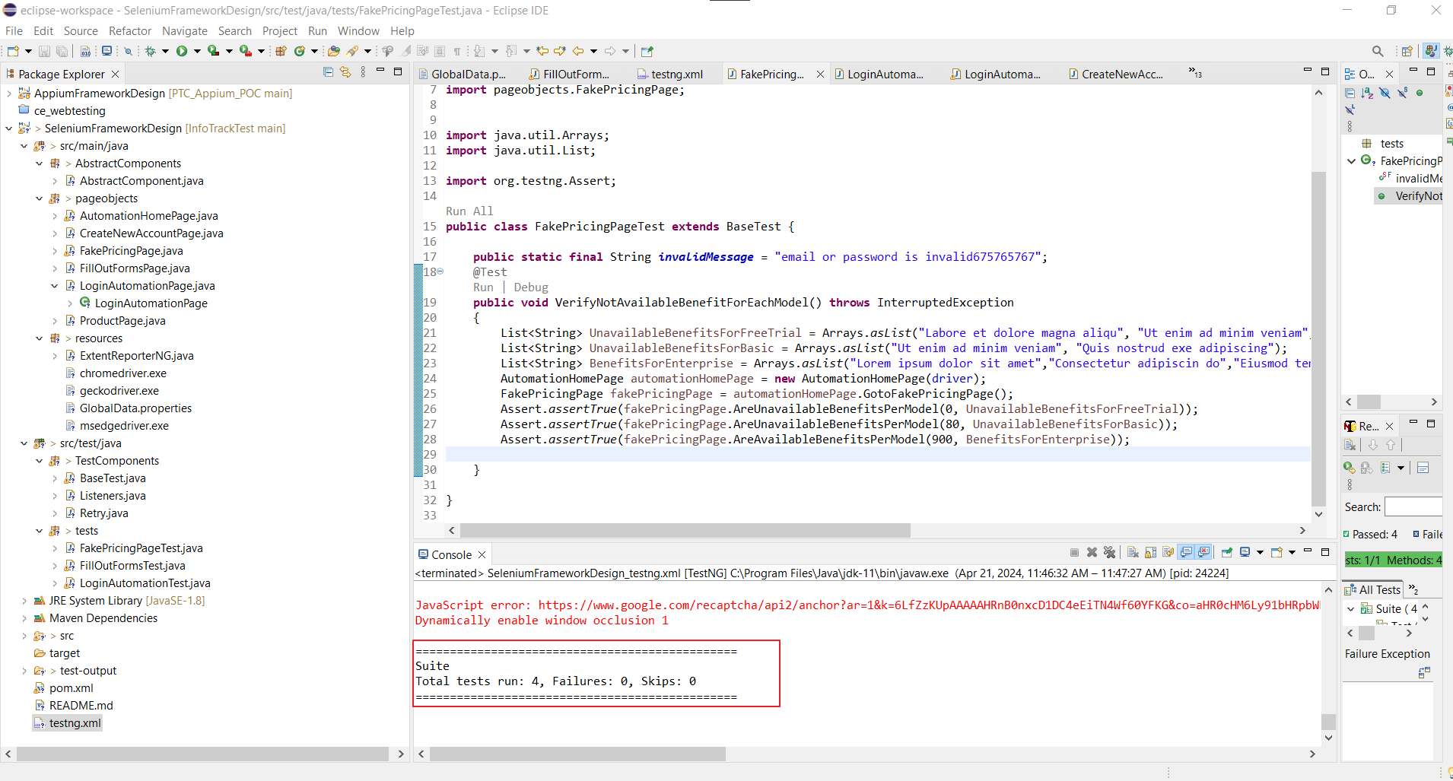
4. HTML Report
After running the test scripts, the html report will be stored in InfoTrackTest\Test Automation\SeleniumFrameworkDesign\test-output

Slide 7
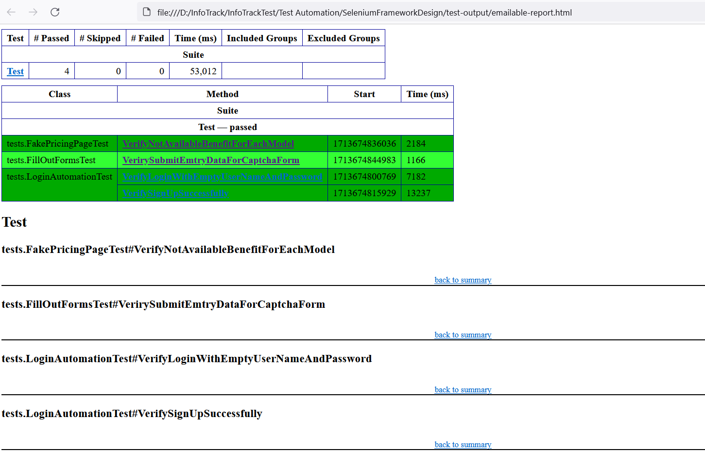
4. HTML Report

Slide 8
THANK YOU

